Slide 1
Procedural Terrain Generation
Qitong Liu and Ryan Vera

Slide 2
Outline
Definition
Algorithm Overview
Perlin Noise
Diamond Square
Results and Evaluation

Slide 3
What is Procedural Terrain Generation
Method used to create landscapes algorithmically rather than manually
Uses mathematical models, algorithms, and randomness to simulate realistic terrains

Slide 4
Perlin Noise

Slide 5
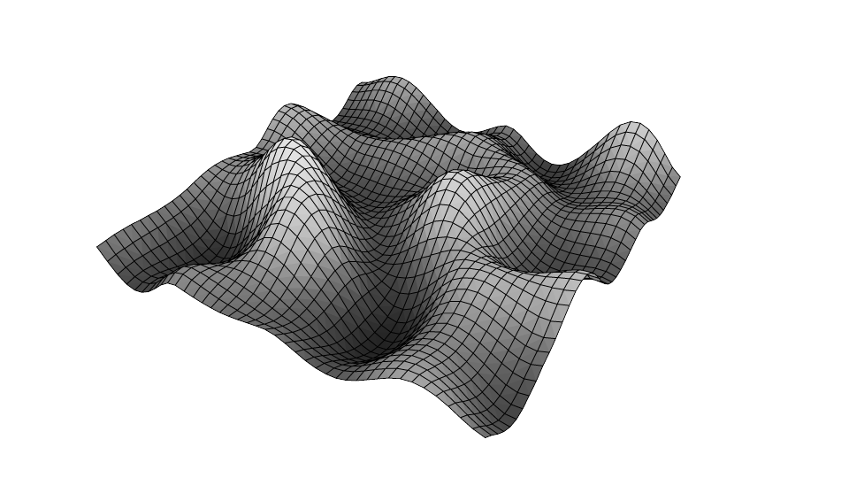
Perlin Noise Overview
Created by Ken Perlin in 1983
Produces smooth transition between values
Ideal for organic patterns

Slide 6
Perlin Noise Pseudocode

Slide 7
Diamond Square

Slide 8
Diamond Square Overview

